Slide 1

Accessing Database with Python
SQL Magic

Slide 2
Outline
Python for DBMS?
Jupyter Notebook for DBMS
SQL API’s
Popular SQL Based DBMS Systems
SQLite, SQL Magic
Hands-On Exercise with Chinook Database

Slide 3
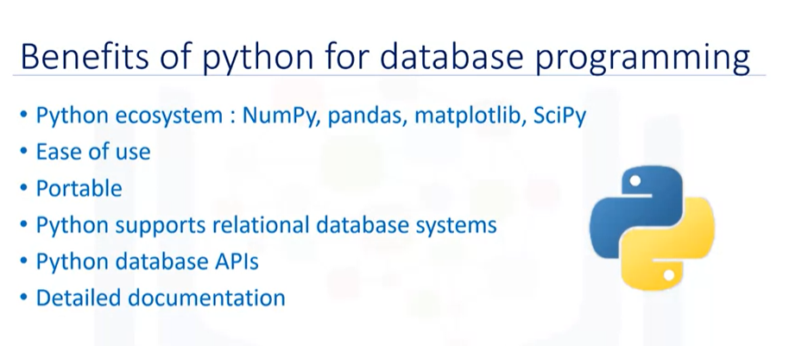

Slide 4
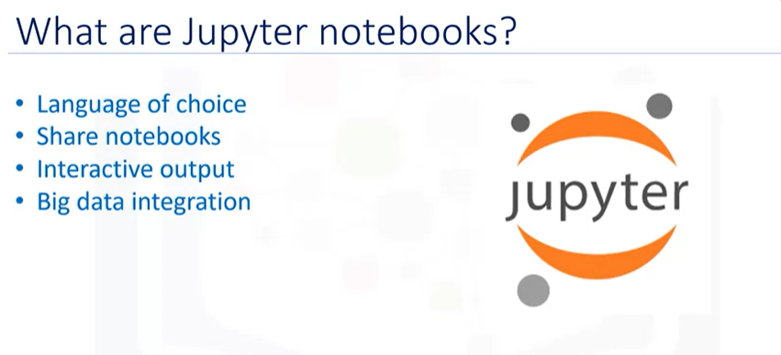
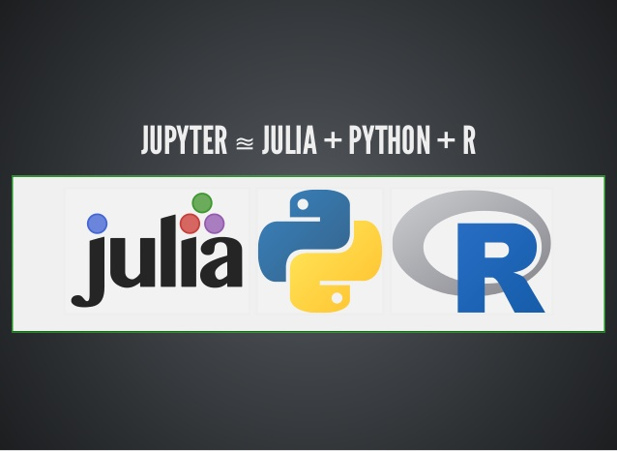

Slide 5
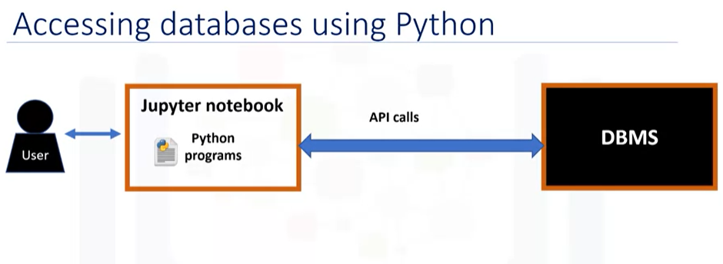
* Application Programming Interface

Slide 6
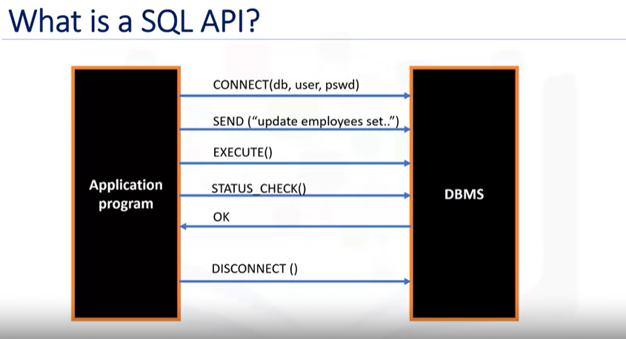

Slide 7
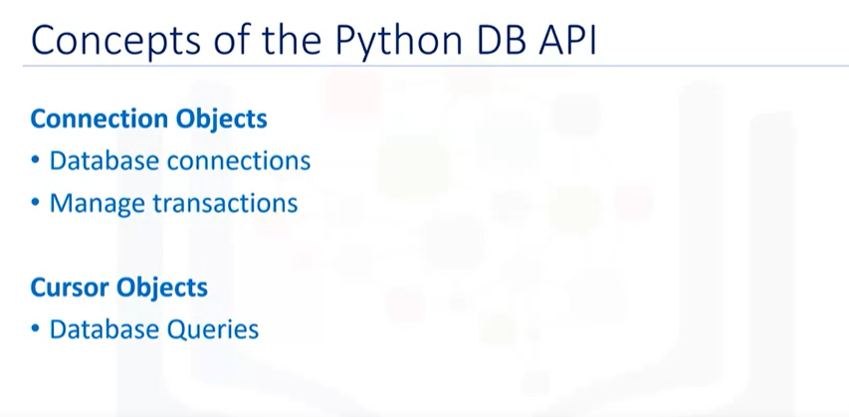
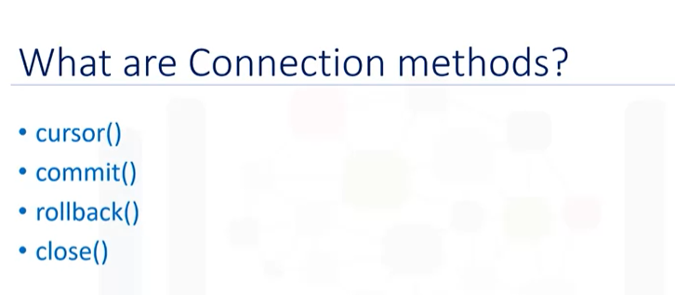
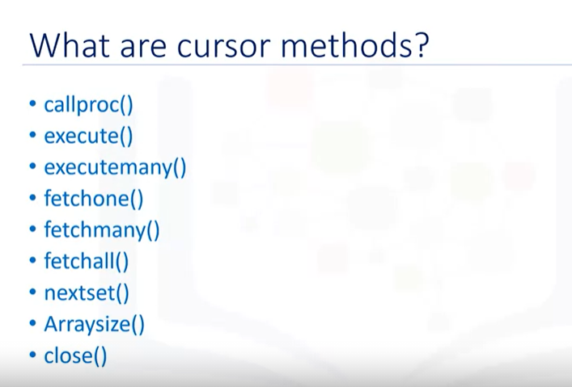

Slide 8
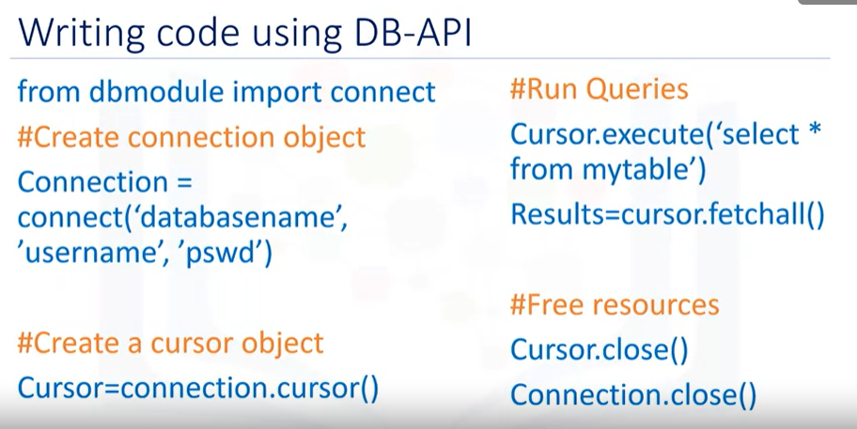

Slide 9
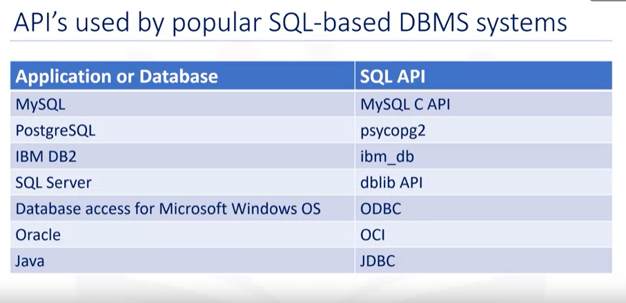

Slide 10

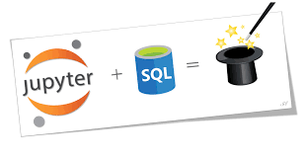

Slide 11
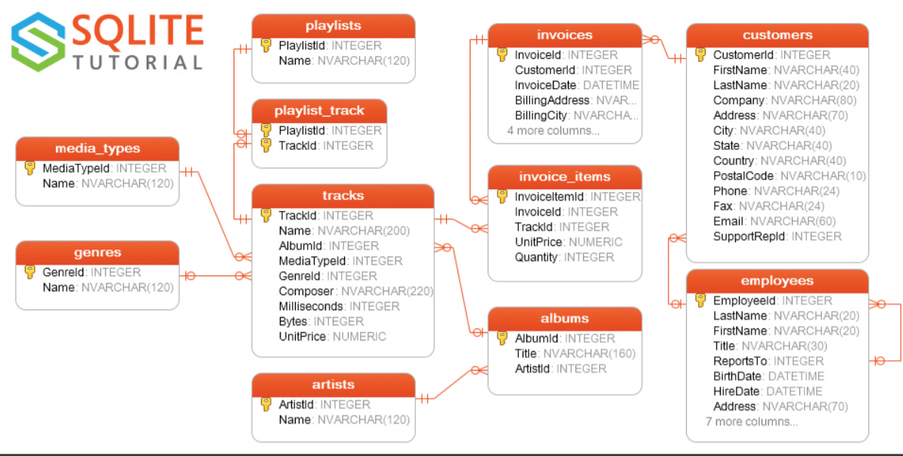
CHINOOK DATABASE

Slide 12
Questions… Thanks for listening..

